Slide 1
PET
DOCTOR
APP
BUSINESS PLAN
Pet Doctor APP
BUSINSS PLAN
宠物医生移动应用商业计划
Group members：杜卓航, 李苛垚, 黄熙晋, 鲍忠正

Slide 2
PET
DOCTOR
APP
01
Description of the Business
业务描述
02
Market Analysis
CONTENTS
市场分析
BUSINSS PLAN
目录
03
Business Operations
商业运作

Slide 3
PET
DOCTOR
APP
PART ONE
Description of the Business
BUSINSS PLAN
1.1 Who Are We?
1.2 Our Target
PART ONE

Slide 4

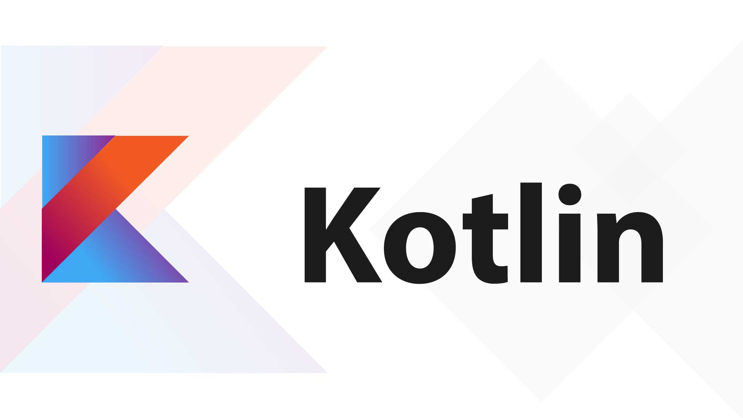

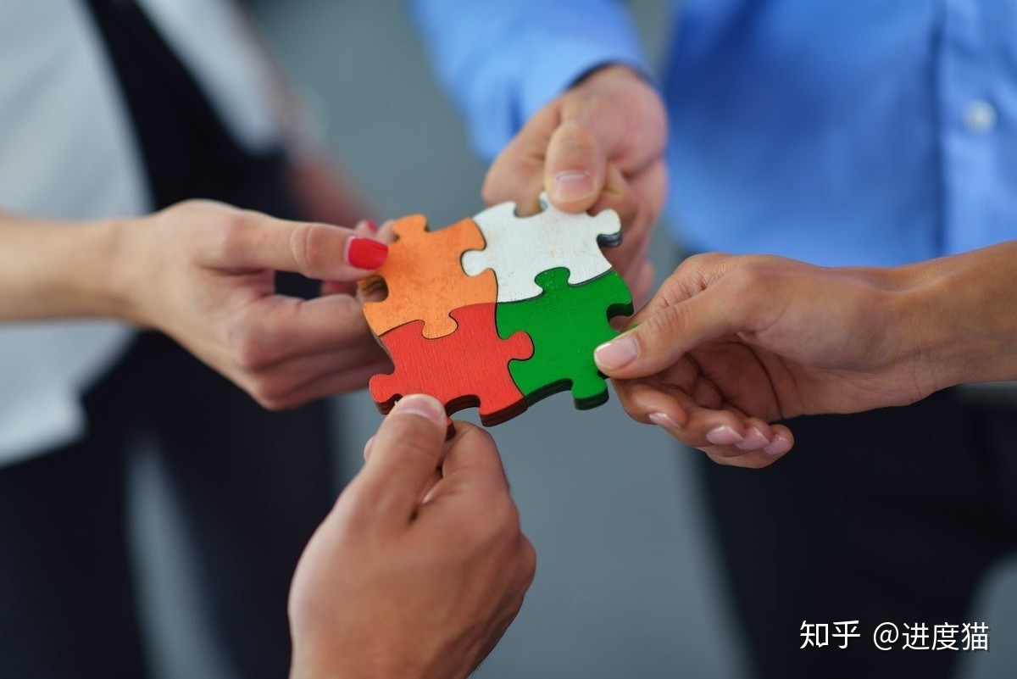
Description of the Business
1.1
公司陈述
About us
International Vision
Skilled Programming
We are from the Aberdeen Institute of Data Science and Artificial Intelligence, South China Normal University . At present, there are 4 members in our team, two of whom major in SE and two of whom major in IMIS. This gives us not only excellent programming skills, but also considerable business knowledge. At the same time, we also have an international perspective and a good team culture.
Business Capability
Good Teamwork
Notes:
不讲，过

Slide 5
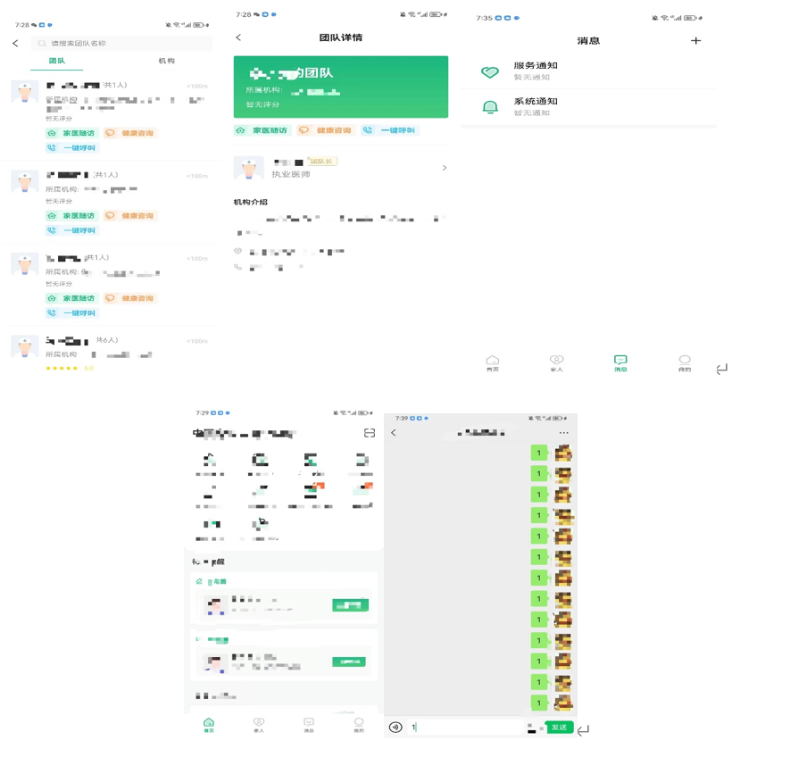
Description of the Business
1.2
公司陈述
Services
While using our app, customers are able to
Chose different medical groups which they may think is suitable for their problem
Have a detail overview of the information of groups
Communicate with our doctors and be informed when doctors reply
Navigate to different services which we will put forward sooner

Slide 6
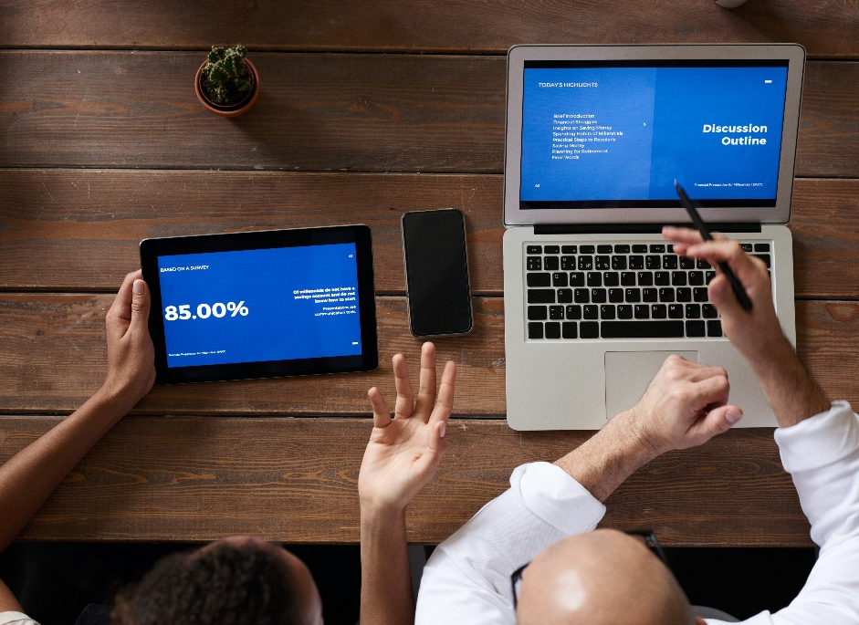
Description of the Business
1.3
公司陈述
Target
The app aims to provide users with more convenient online pet medical consultation services. We are committed to providing users with high-quality, safe and convenient pet family doctor services. We will continue to improve and refine our Family Doctor App to meet the changing needs and expectations of our users.
There will be more...

Slide 7
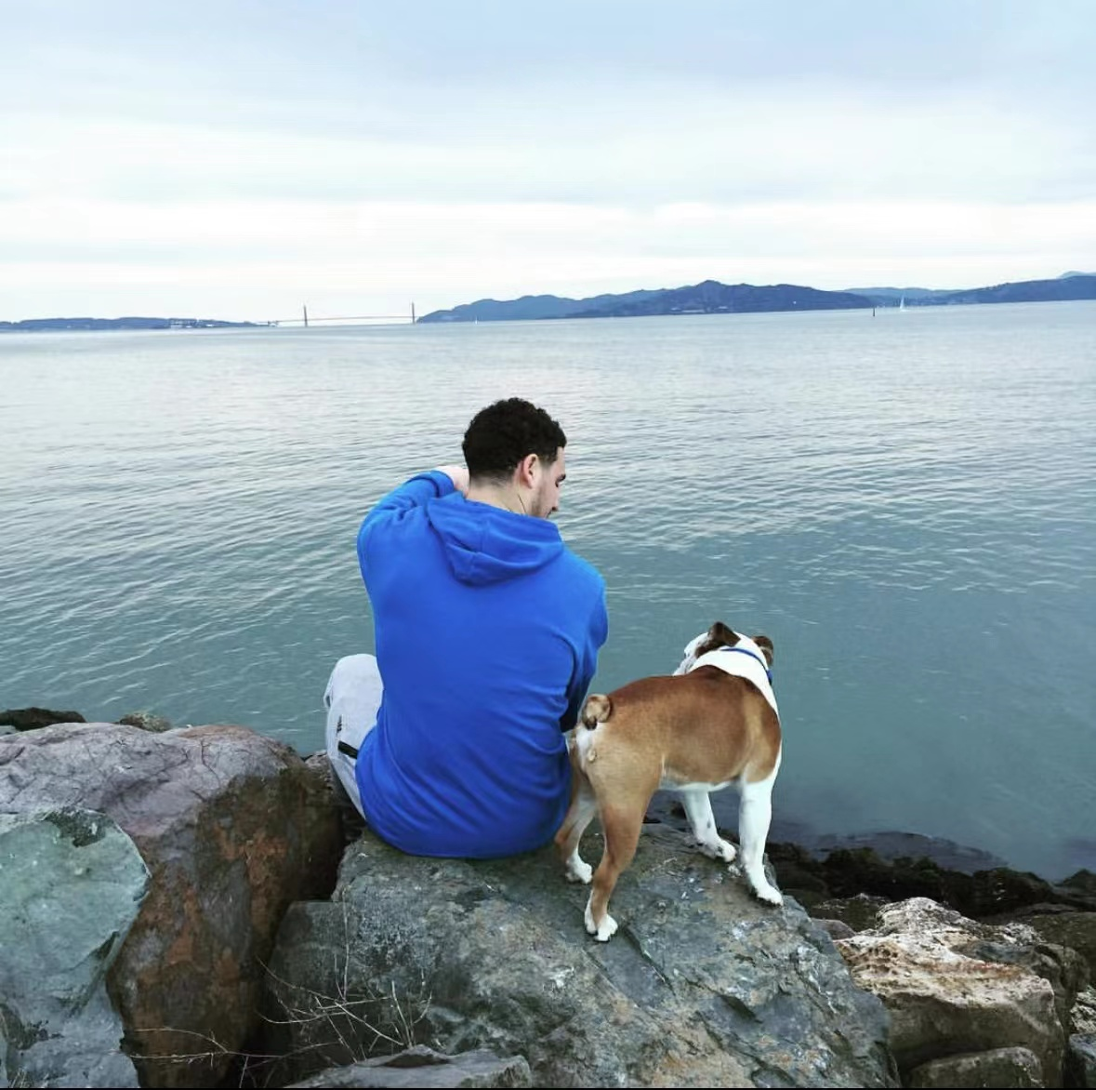
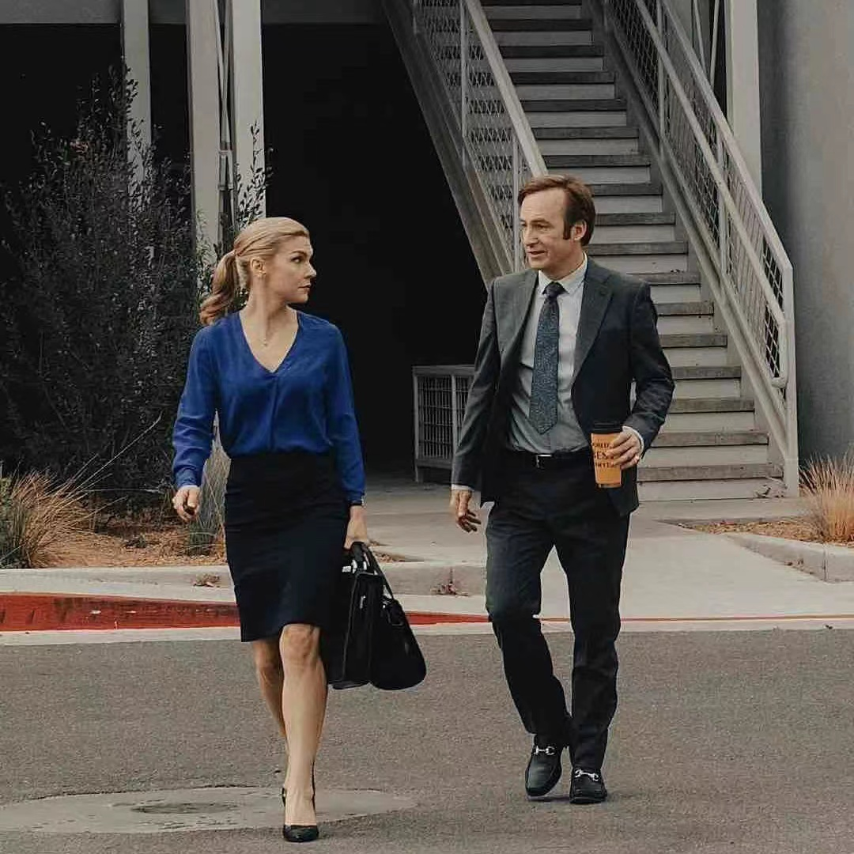
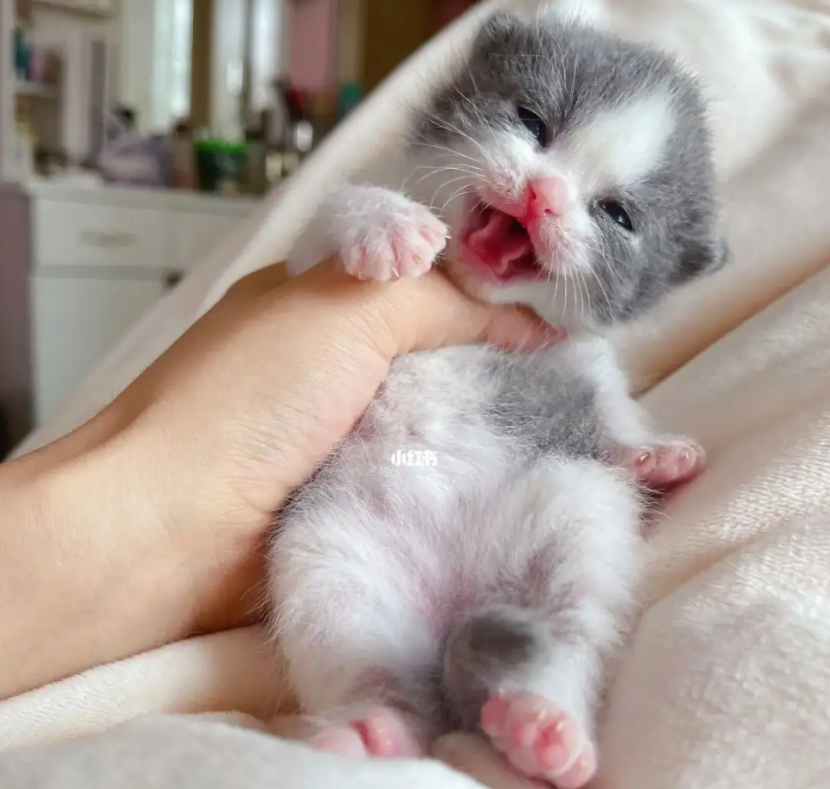
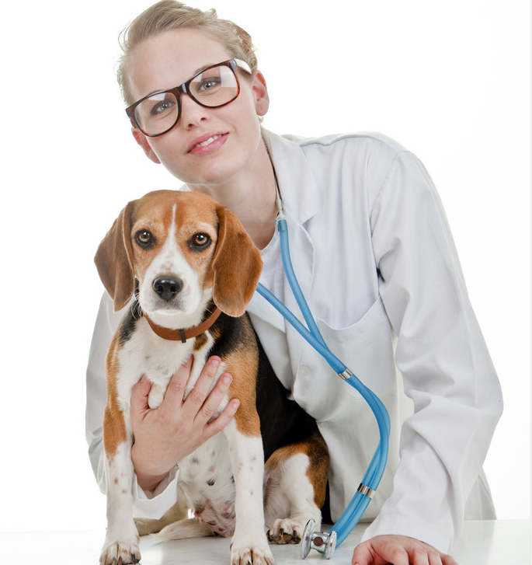
Market Analysis - User Persona
2.3
市场分析- 用户画像
Pet Owner
Busy Urbanites
Pet Novices
Veterinarian
01
02
03
04
The primary users of the software are pet owners who care about the health and well-being of their pets and are willing to spend money and time on pet care and maintenance.
They do not have enough time to go to the hospital or veterinary clinic in their busy work and life, but they want to keep abreast of their pets' health status and get professional advice.
These people are not very knowledgeable about pet care and need professional guidance and advice.
The software can provide a communication platform for veterinary and pet medical practitioners to share experiences and knowledge.

Slide 8
PET
DOCTOR
APP
PART TWO
Market Analysis
BUSINSS PLAN
2.1 Porters Competitive Forces Model
2.2 Swot Analysis
2.3 User Persona
PART TWO

Slide 9
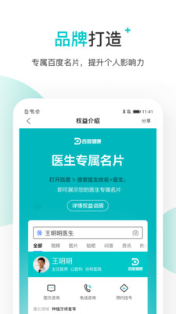

Market Analysis
2.1
市场分析-波特竞争力量模型
Porters
Competitive
Forces Model
1. Rivalry
Currently, the most authentic online medical platforms are Dingxiang Doctor and Baidu's Baidu Health. However, their main strategic direction is the online medical treatment for people. Therefore, the online medical platform market for pets is still relatively vacant at present, and the prospect of this direction is quite ideal.
2. Threat of New Entrants
With the improvement of people's living quality, the gap in the pet market will become larger. Therefore, the demand of related industries, such as the pet medical industry, will increase, and the future market scale will increase the competitiveness of potential competitors.

Slide 10
Market Analysis
2.1
市场分析-波特竞争力量模型
Porters
Competitive
Forces Model
3. Supplier Bargain Ability
Suppliers of online pet medical platform are doctors with veterinary qualifications and suppliers of pet medical equipment. Currently, the purchase rate of veterinary medicine and equipment on major e-commerce platforms is not high. A highly integrated platform will bring huge benefits to suppliers, so the bargaining power of suppliers is not high.
4. Buyer Bargain Ability
The buyers of the online pet medical platform are families with pet health problems. For these buyers, the need to solve the pet health problems without leaving the house is quite urgent, so the buyers have low bargaining power.
5. Threat of Substitution
Alternative products are those that perform the same functions as products in the industry. Such as other pet medical service providers, offline pet hospitals, etc.

Slide 11
Market Analysis - Swot Analysis
2.2
市场分析- Swot分析
01
Strengths
new business model
Innovative Business Model
02
Market Requirement
1.growing market. 2.Increasing number of pet consumers
Convenience
03
solves consumer’s problems

Slide 12
Market Analysis - Swot Analysis
2.2
市场分析- Swot分析
Weaknesses
Fierce Competition
Supplier Dependent
The pet medical market will be highly competitive in the future. Therefore, the family pet doctor App needs to develop an effective marketing strategy to attract more users.
Family Pet Doctor App needs to establish a good relationship with suppliers to ensure the provision of high-quality pet medical services.

Slide 13



Market Analysis - Swot Analysis
2.2
市场分析- Swot分析
Opportunities
Market Size Growth
Reforming Tendency
As the demand and attention for pets continues to increase, the pet medical market will continue to grow, providing more opportunities for family pet doctor apps.
Digitalization, mobility and intellectualization are the trends of today's society, which provides more opportunities for family pet doctor App to meet the needs of consumers.

Slide 14
Market Analysis - Swot Analysis
2.2
市场分析- Swot分析
Policies and Regulations
The pet medical industry is regulated by policies and regulations, so the family pet Doctor App needs to comply with relevant regulations and regulations, or it may be subject to fines and other penalties.
Threats
Network Security
The Pet Doctor App needs to protect users' privacy and security to prevent hackers, data leakage and other security problems.
Economic Environment
The uncertainty of macroeconomic environment may have an impact on the business and development of family pet doctor App, such as inflation, economic contraction and other factors.

Slide 15
PET
DOCTOR
APP
PART THREE
Business Operations
BUSINSS PLAN
3.1 Business Model
3.2 Marketing Strategies
PART THREE

Slide 16
Business Operations
3.1
商业运作-商业模式
Contract Signing Model
We will provide contract service, so that users can get more comprehensive and personalized pet family doctor service. The contracted service will be divided into different levels to meet users' different needs and budgets.
Business Model
Advertising & Promotion Revenue
The business model of our Pet Doctor app student development team is based on the following 3 aspects:
We will display ads and sponsors' promotional information in the App to generate revenue. Advertising will be targeted according to the interests and needs of users to improve the effectiveness of advertising and promotion and user experience.
Intermediary Service Model
We may introduce pet insurance, family doctor visits and so on. The platform generates revenue through agency fees.

Slide 17
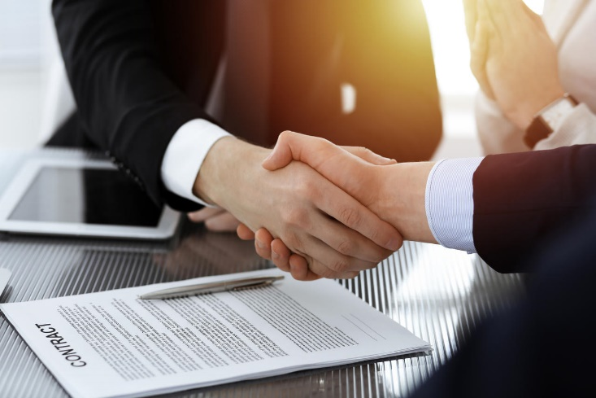
Business Operations
3.1
商业运作-商业模式
Contract Signing Model
We will provide contract service, so that users can get more comprehensive and personalized pet family doctor service. The contracted service will be divided into different levels to meet users' different needs and budgets.

Slide 18
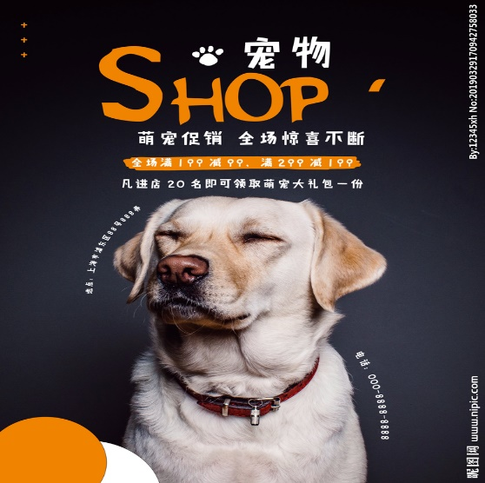
Business Operations
3.1
商业运作-商业模式
Advertising & Promotion Revenue
We will display ads and sponsors' promotional information in the App to generate revenue. Advertising will be targeted according to the interests and needs of users to improve the effectiveness of advertising and promotion and user experience.

Slide 19
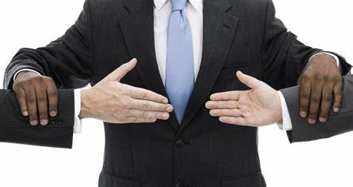
Business Operations
3.1
商业运作-商业模式
Intermediary Service Model
We may introduce pet insurance, family doctor visits and so on. The platform generates revenue through agency fees.

Slide 20
Business Operations
3.2
商业运作-营销策略
Cooperation
Press Release
Marketing Strategies
Expand our expertise and reach by partnering with veterinary schools and pet hospitals. We can provide internship platform for schools and propaganda means for pet hospitals.
We will actively seek media coverage and publicity to expand our visibility and influence.
Marketing channels:
Our family doctor student development team will likely use the following channels to promote and market our App
Public Activities
Social Media
We will organize some public relations activities, such as health lectures, medical and health forums, etc., to enhance our brand awareness and user engagement.
We will promote our App through social media platforms, such as wechat, Weibo, b website, etc.

Slide 21
PET
DOCTOR
APP
感谢观看
THANK YOU
BUSINSS PLAN
Group members：杜卓航, 李苛垚, 黄熙晋, 鲍忠正

